Slide 1
ECE 3130 Digital Electronics and Design
Lab 3
Half Adder and 2:1 MUX
Fall 2016

Slide 2
Tips
Always save your user-made components!
Always use a user-made component when possible
To move component, Alt + drag
To rotate, click R

Slide 3
Objectives
Learn how adders and multiplexers work
Build and simulate a half adder
XOR
AND
Build and simulate a 2-to-1 multiplexer
Inverter
NAND

Slide 4
What are adders?
Digital circuits that perform addition of numbers
Half adder
Adds two 1-bit binary numbers
Full adder(next lab)
Adds three 1-bit binary numbers

Slide 5
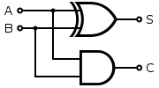
Half Adder
Truth table
Implementation
A | B | Sum | Carry_out
0 | 0 | 0 | 0
0 | 1 | 1 | 0
1 | 0 | 1 | 0
1 | 1 | 0 | 1
XOR Gate
AND Gate

Slide 6
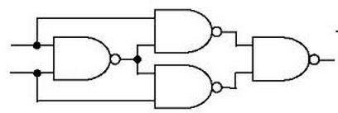
XOR
Truth table
A | B | Output
0 | 0 | 0
0 | 1 | 1
1 | 0 | 1
1 | 1 | 0
Schematic – Option 1

Slide 7
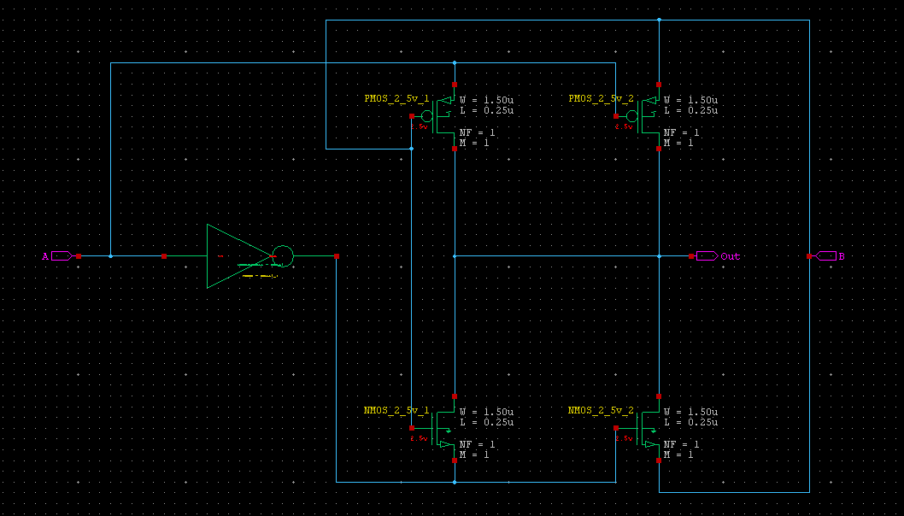
XOR
Schematic – Option 2

Slide 8
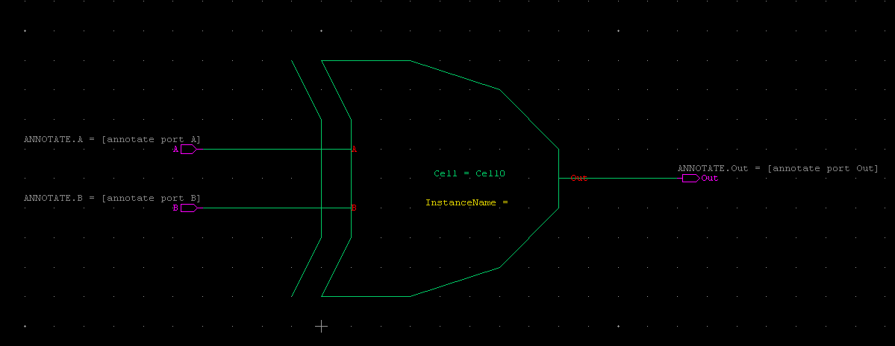
XOR
Symbol

Slide 9
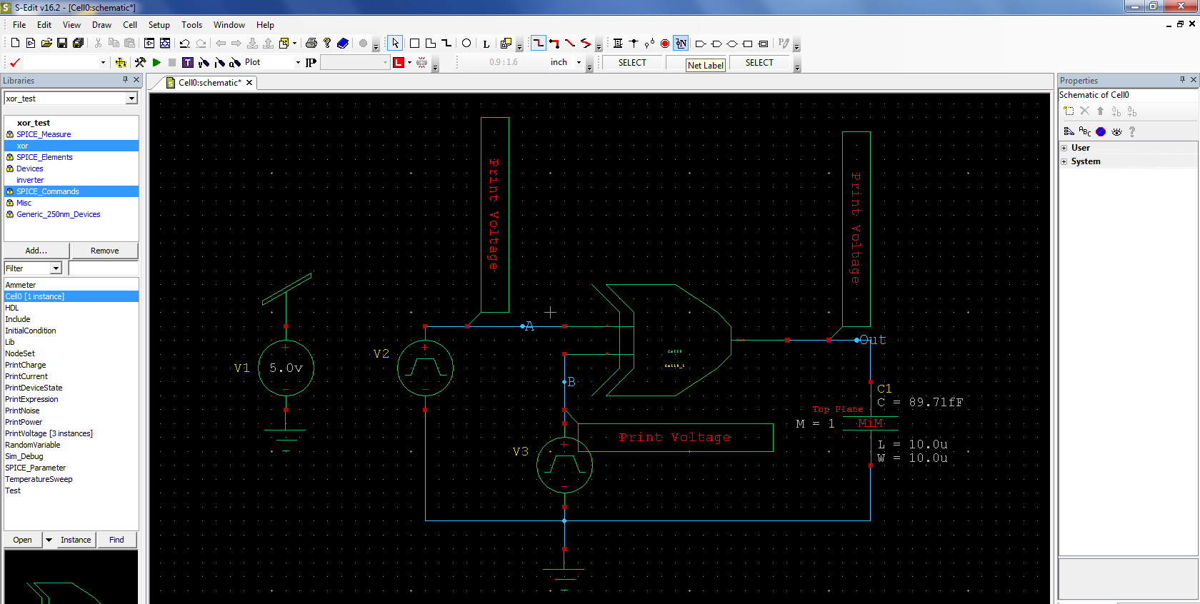
XOR
Add labels to inputs & output
Test circuit schematic
These labels will help to easily identify signals in simulation waveforms

Slide 10
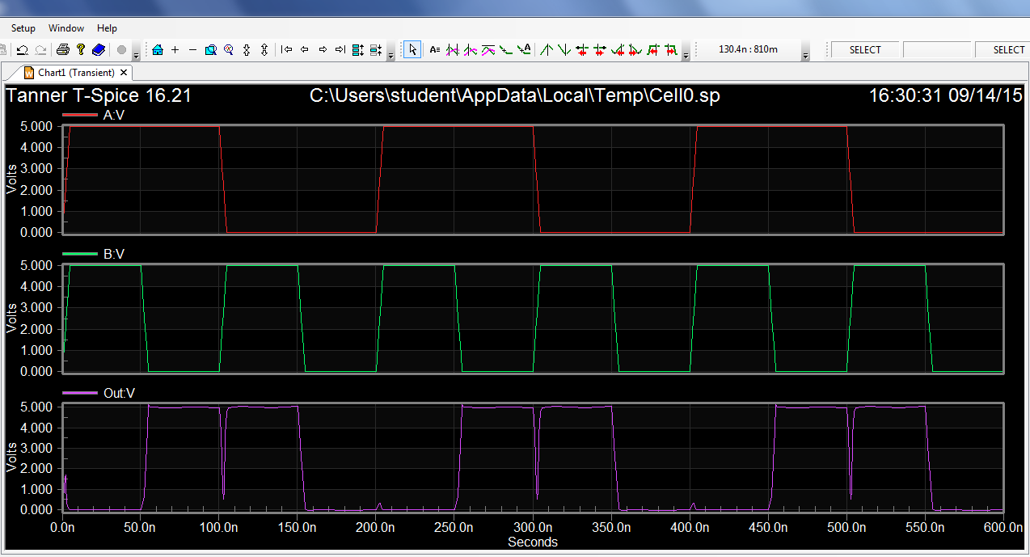
Waveform – XOR

Slide 11
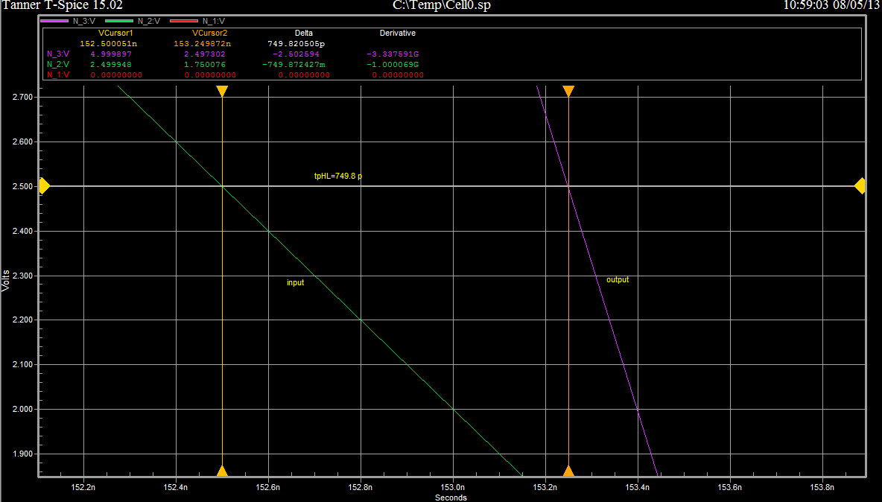
Propagation(XOR) – t_{pHL}
tpHL = 749.8 p

Slide 12
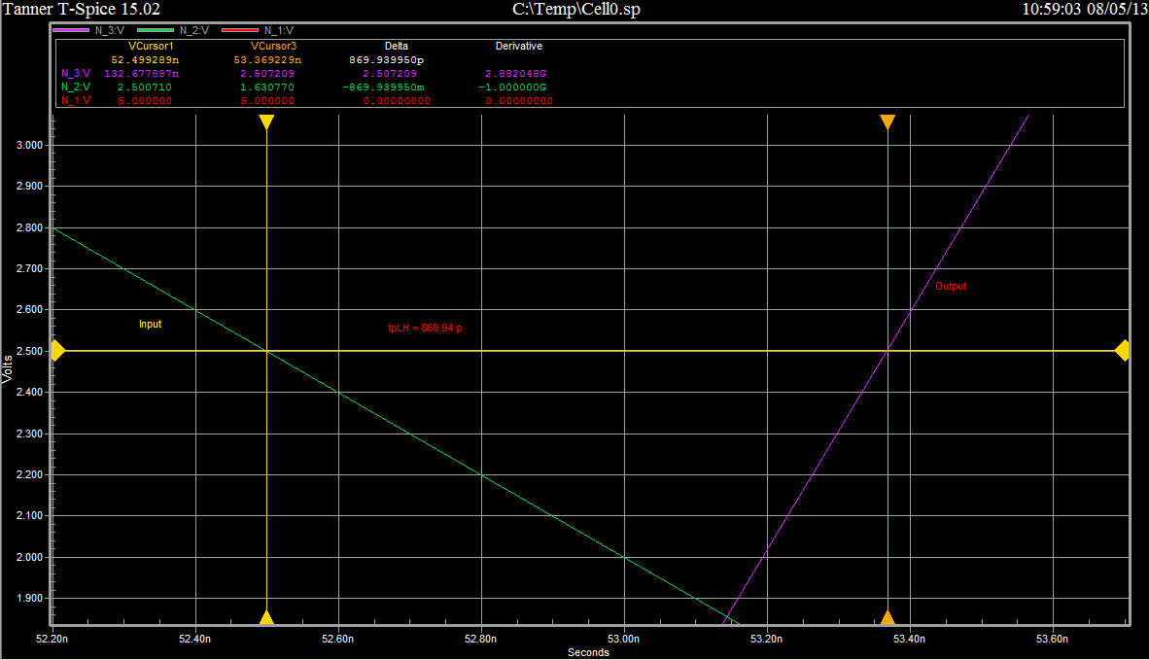
Propagation(XOR) = t_{pLH}
tpLH = 869.94 p

Slide 13
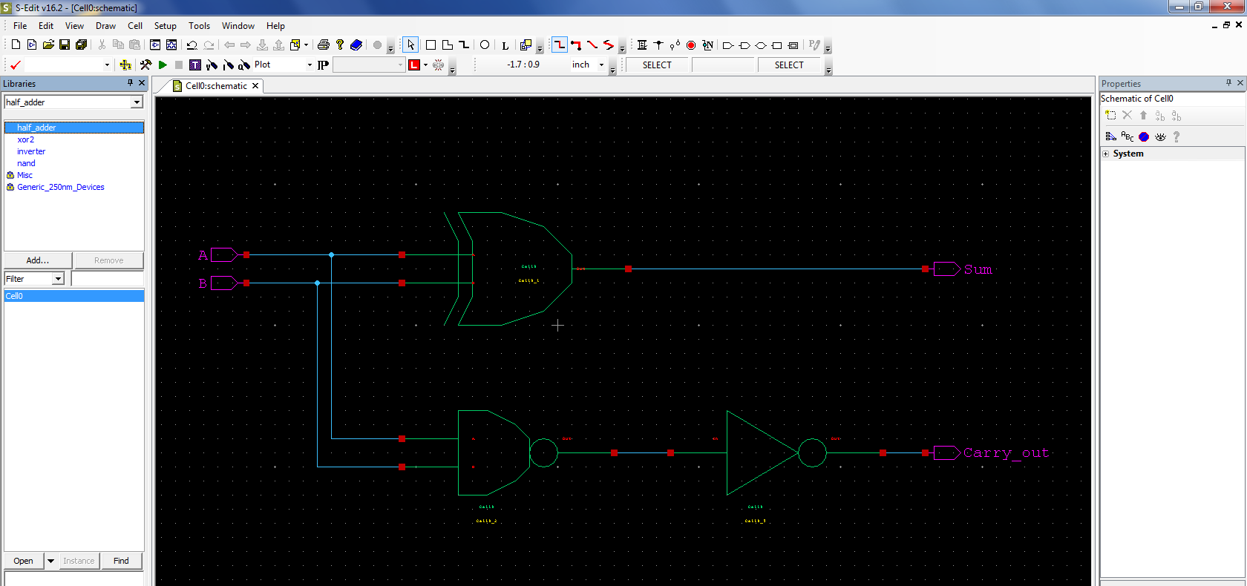
Half Adder - Schematic
NAND + Inverter = AND Gate

Slide 14
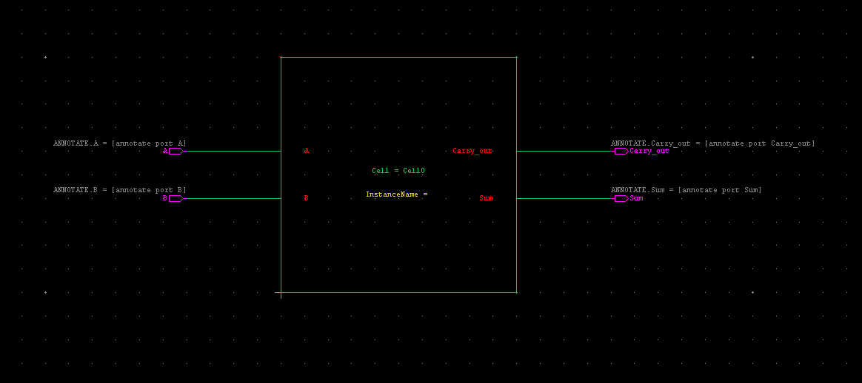
Half Adder - Symbol

Slide 15
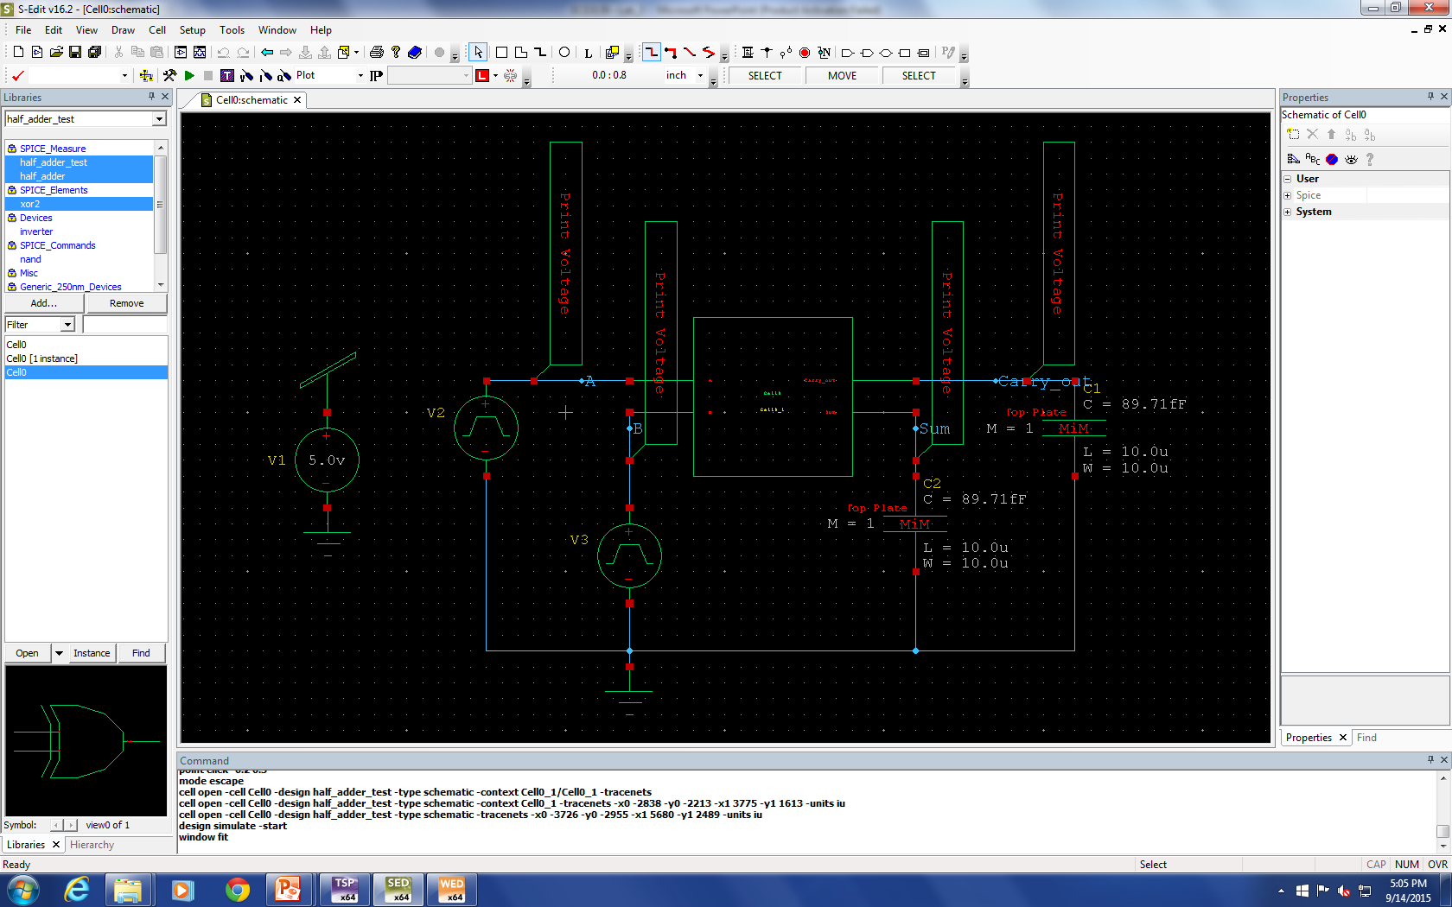
Half Adder – Test circuit

Slide 16

Half Adder - Waveforms

Slide 17
What is a multiplexer (MUX)?
A device with multiple inputs and one output
Also known as a data selector or controlled switch

Slide 18
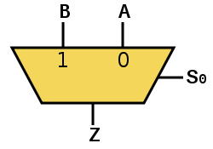
How does it work?
A MUX has n select lines, 2^{n} inputs and 1 output
The select line chooses which input to pass to the output
2-to-1 MUX
Truth table
S | A | B | Z
0 | 0 | 0 | 0
0 | 0 | 1 | 0
0 | 1 | 0 | 1
0 | 1 | 1 | 1
1 | 0 | 0 | 0
1 | 0 | 1 | 1
1 | 1 | 0 | 0
1 | 1 | 1 | 1

Slide 19
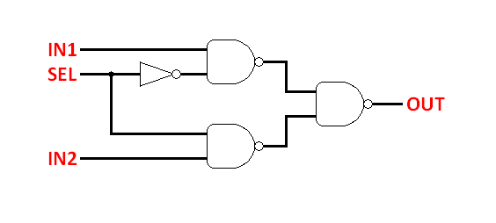
2:1 MUX Gate Implementation

Slide 20

MUX 2:1 – Schematic

Slide 21

MUX 2:1 – Symbol

Slide 22

MUX 2:1 – Test circuit

Slide 23

MUX 2:1 - Waveform

Slide 24
Assignment
Build and simulate a half-adder and a 2:1 MUX
Attach all screenshots into one PDF file, including schematic, symbol, test circuit schematic, waveforms.

